Slide 1
EMMITANCE MEASUREMENT AND ERROR STUDY
21.08.2026
Ramazan Tunç

Slide 2
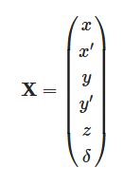
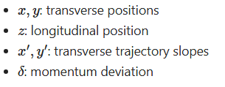


WHAT IS A BEAM
A beam is a collection of particles traveling together.
The motion of each particle is described relative to a reference particle.
A single particle can be described by a six-dimensional phase-space vector

Slide 3


Beam Transport
A particle's coordinates change as it moves through the beamline.
A B C

Slide 4
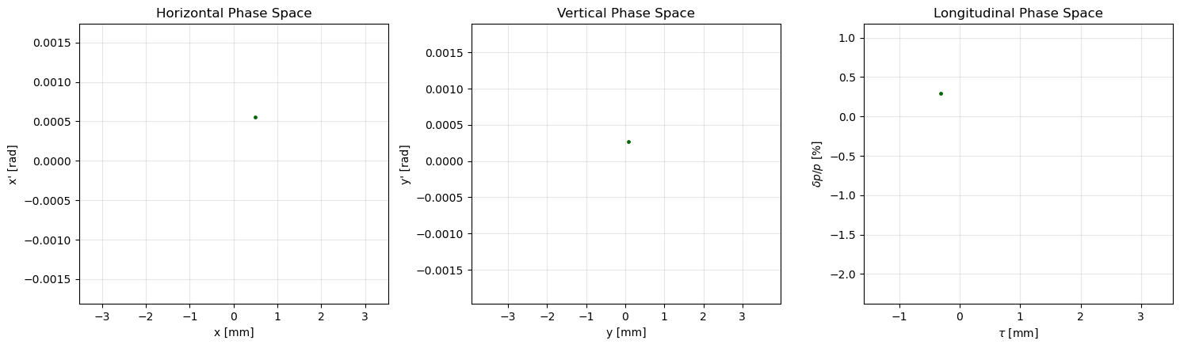
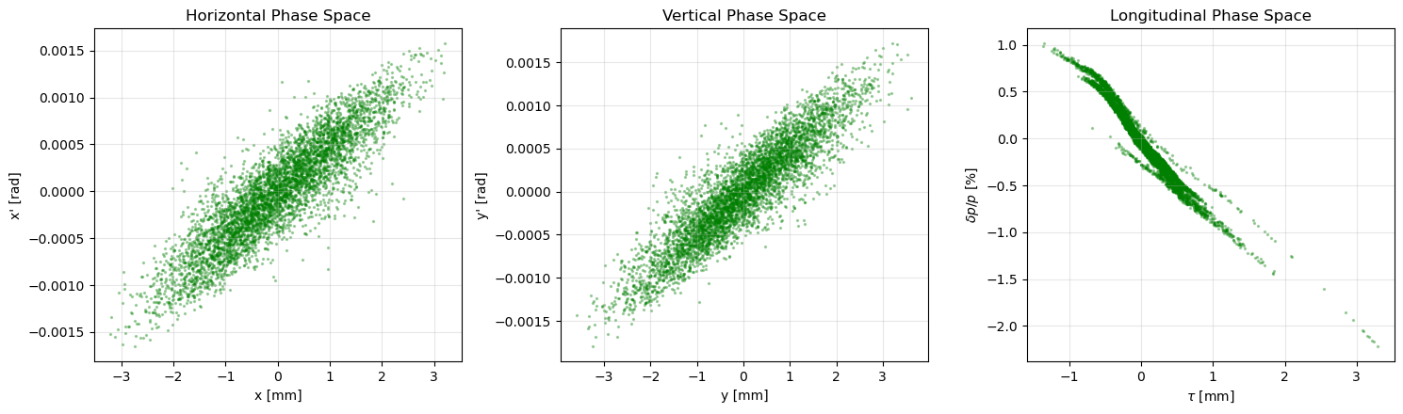
Phase Space
A beam can be represented in phase space
Each particle is represented by one point

Slide 5
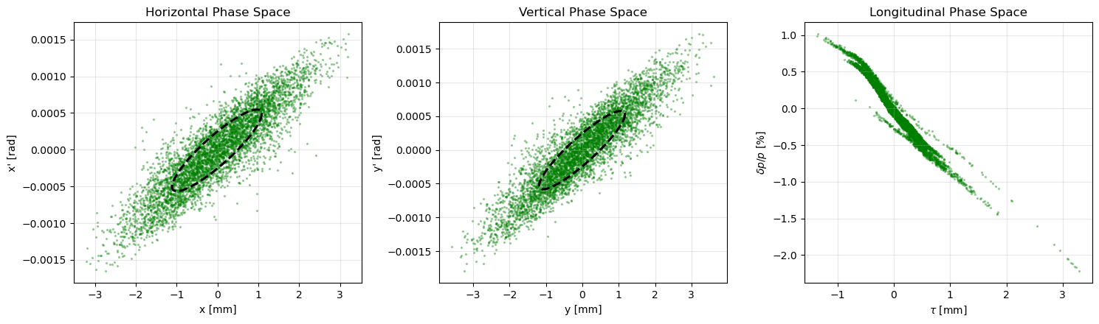
Twiss Parameters
The transverse distribution can be represented by an ellipse
The phase-space ellipse is described by the emittance and Twiss parameters

Slide 6
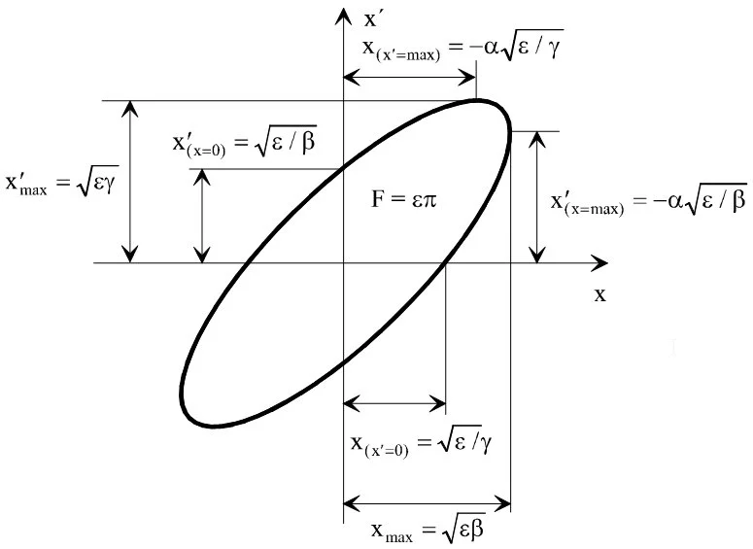







Twiss Parameters
Emittance
Emittance determines the overall size of the phase-space ellipse.
Beta
Beta describes the spatial width of the beam.
Alpha
Alpha describes the correlation between position
and trajectory slope and determines the tilt of the ellipse.
Gamma
Gamma describes the angular spread of the beam.
The Twiss parameters satisfy

Slide 7
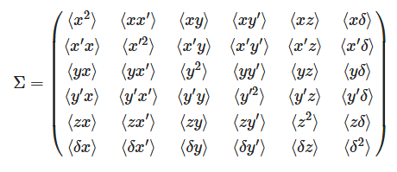
Beam Matrix
The phase-space distribution can be described by a beam matrix

Slide 8







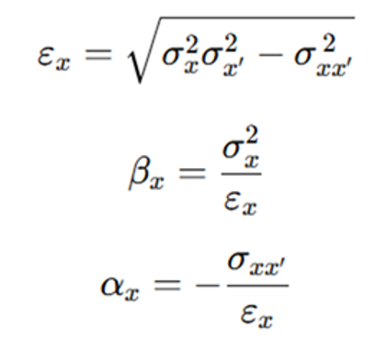


Beam Reconstruction
We can treat each block of the matrix separately for independent analysis when the beam is not coupled.
the beam matrix is transported according to this equation

Slide 9
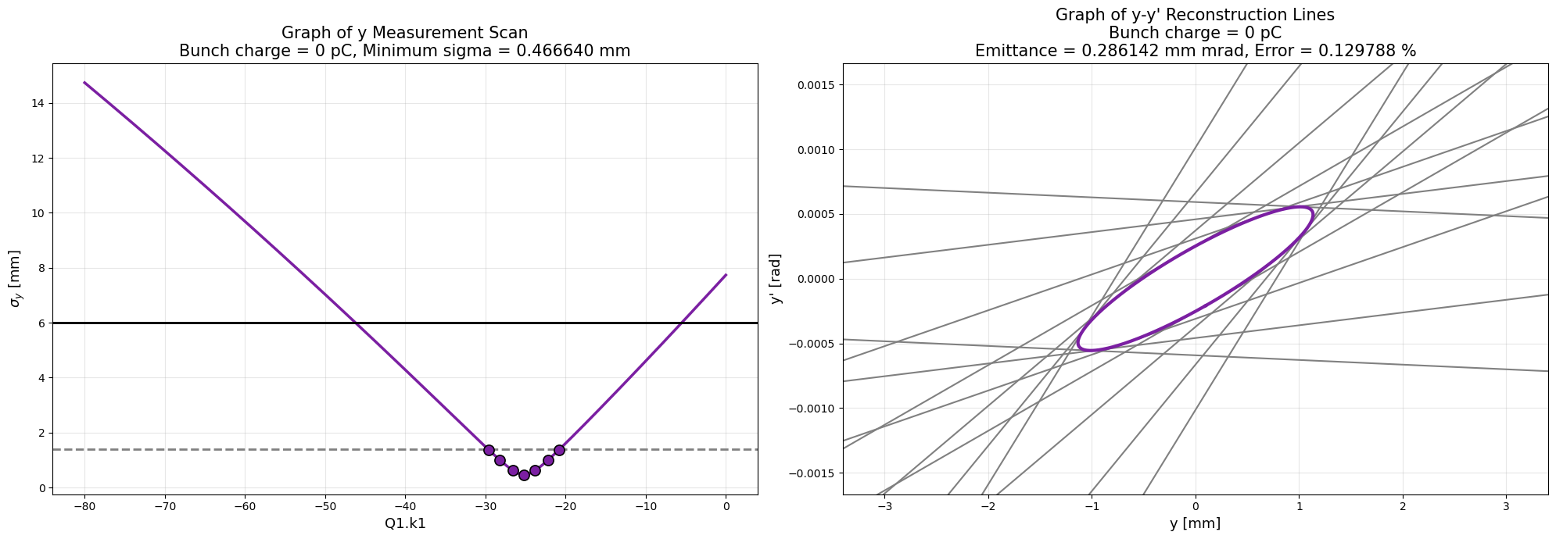

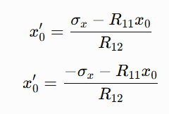

======

Slide 10
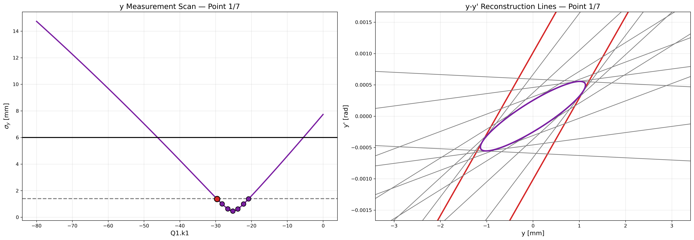

Slide 11


Slide 12
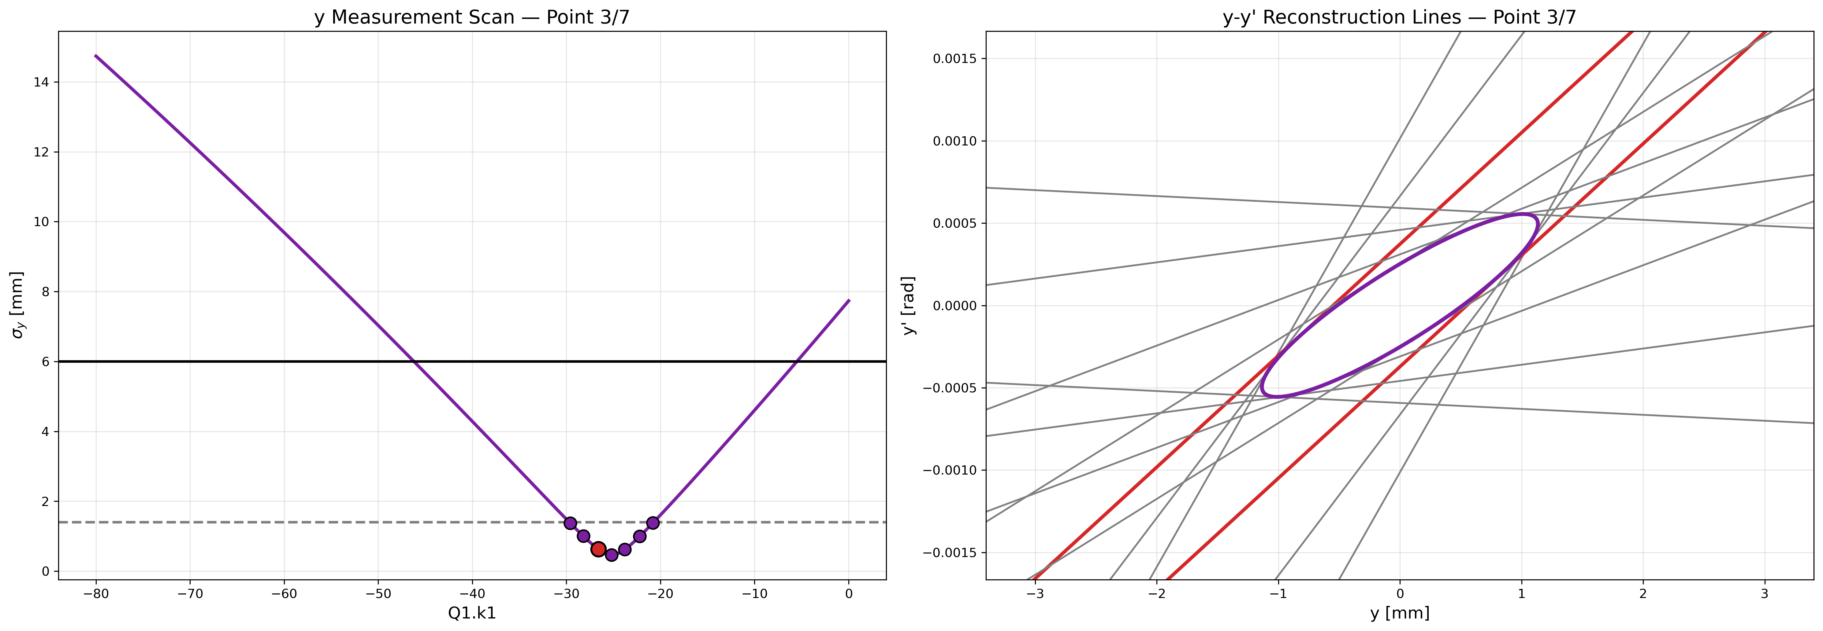

Slide 13
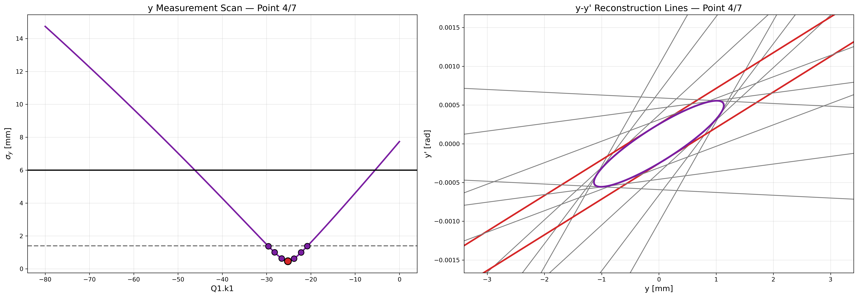

Slide 14
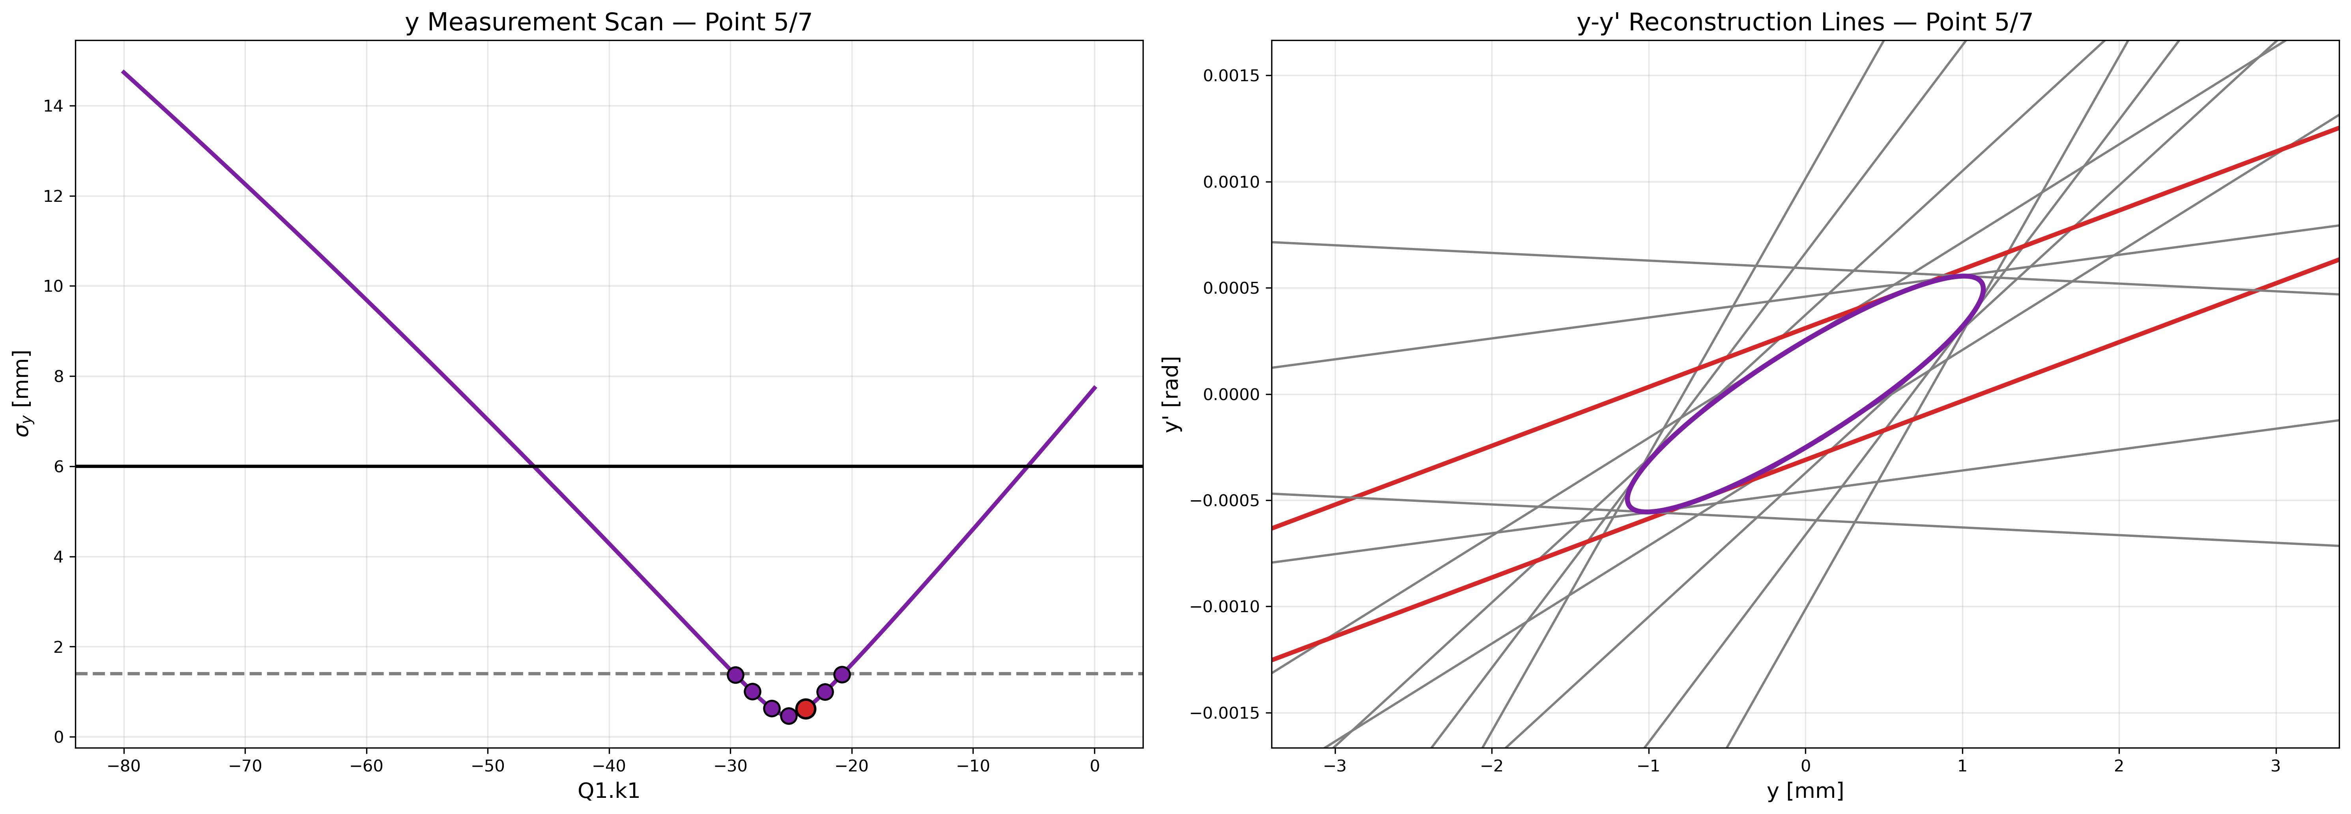

Slide 15
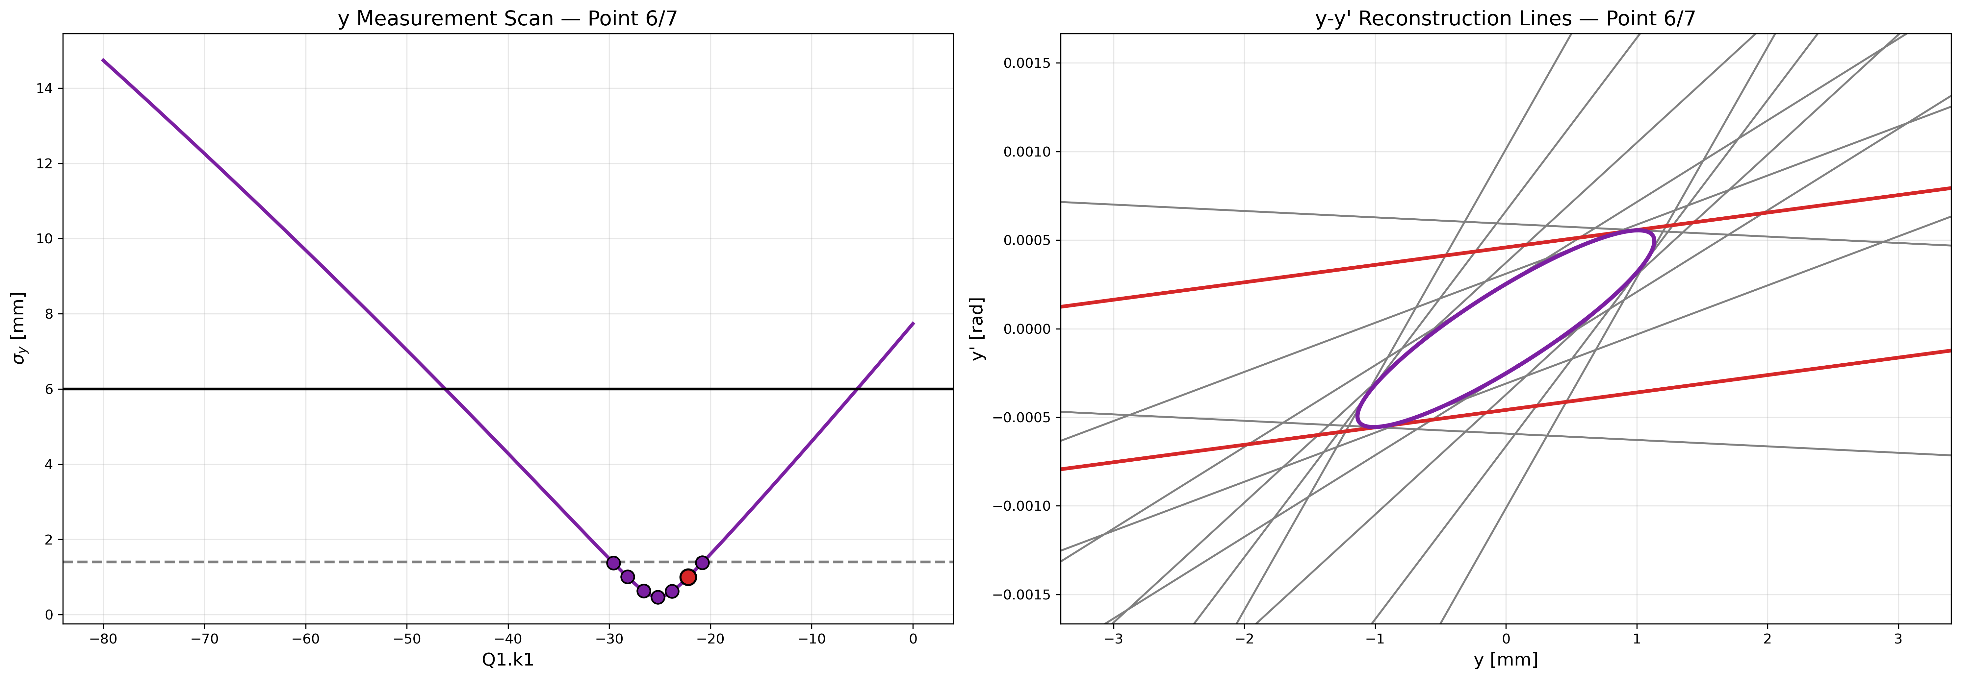

Slide 16
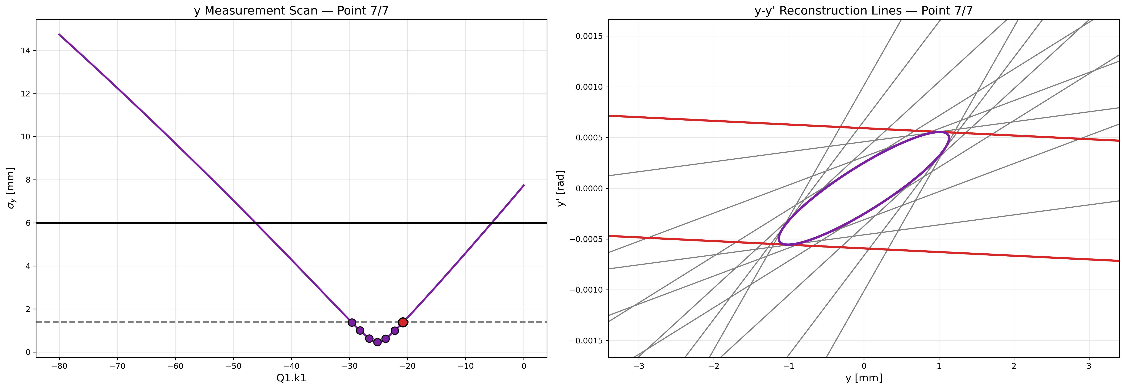

Slide 17
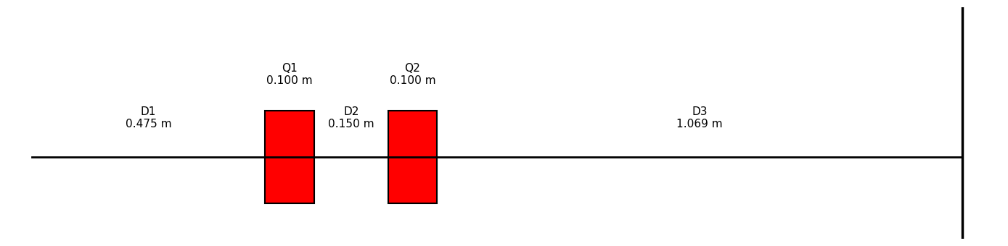
BEAMLINE

Slide 18
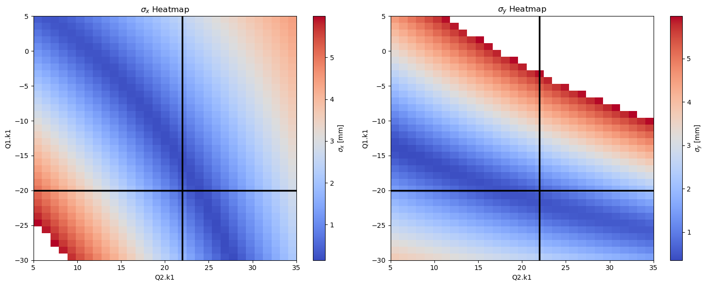
HEATMAPS
First Quadrupole: k = -20
Second Quadrupole: k = 22

Slide 19
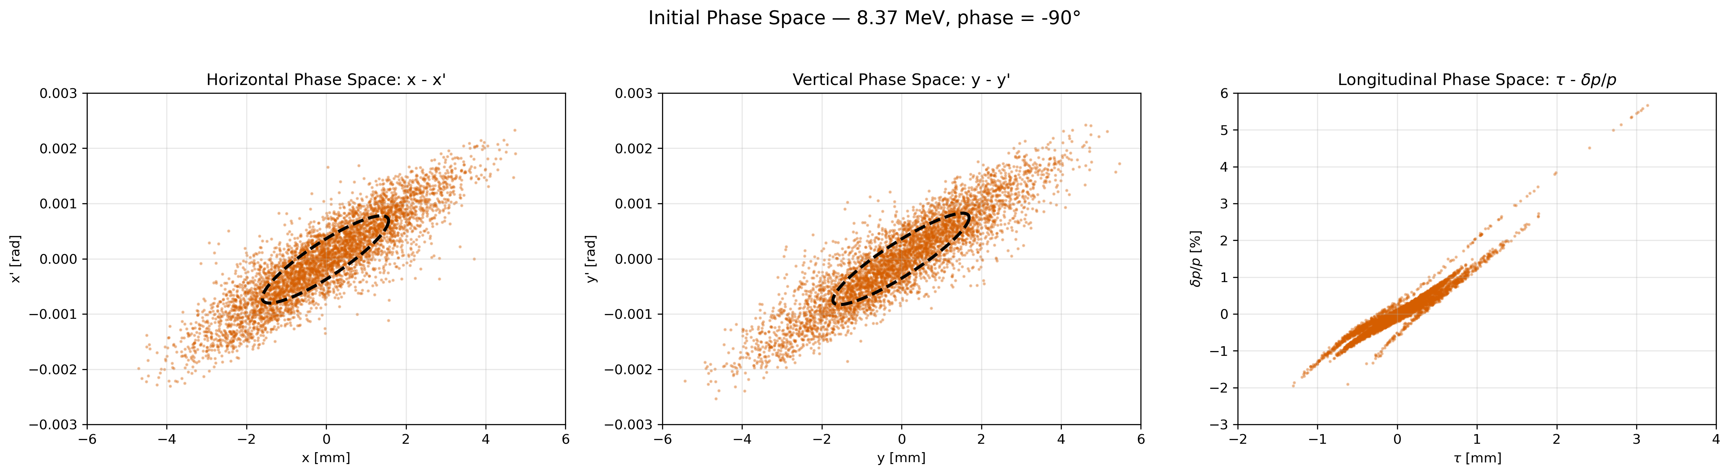
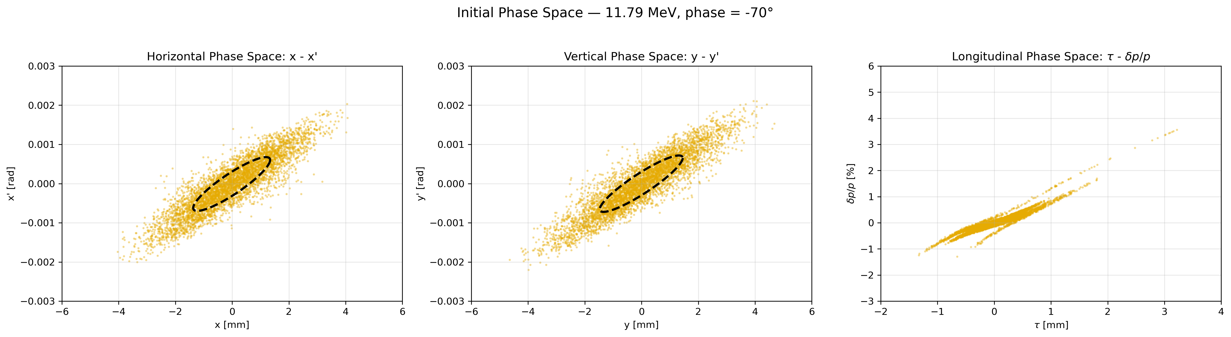
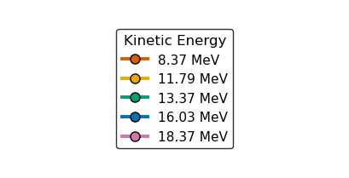
BEAM FILES

Slide 20
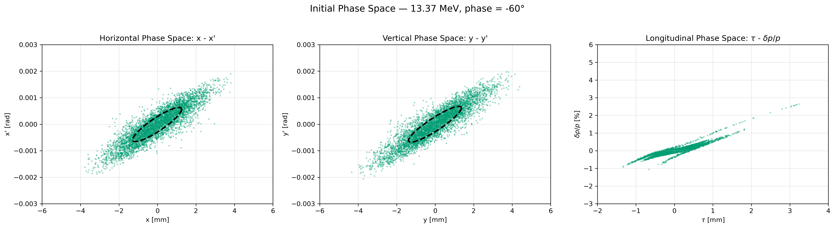
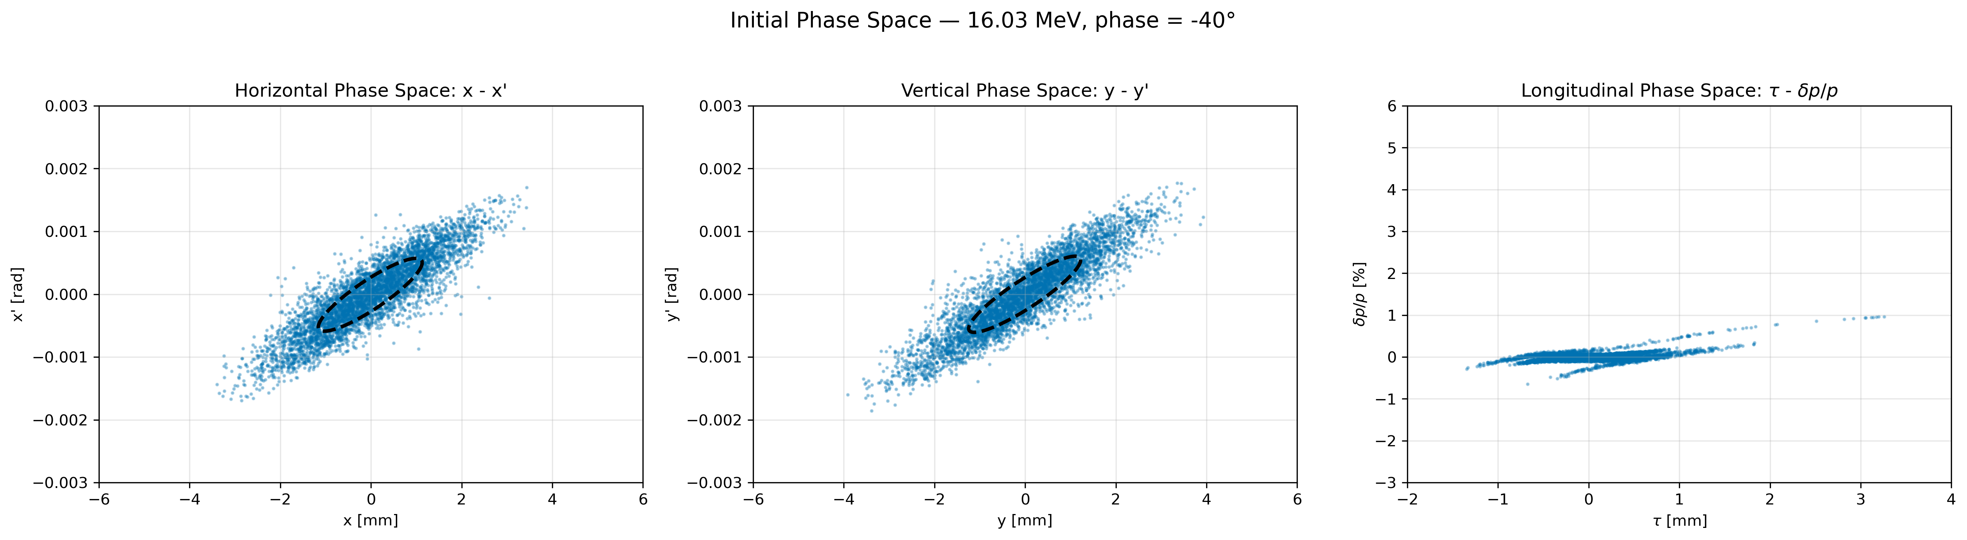
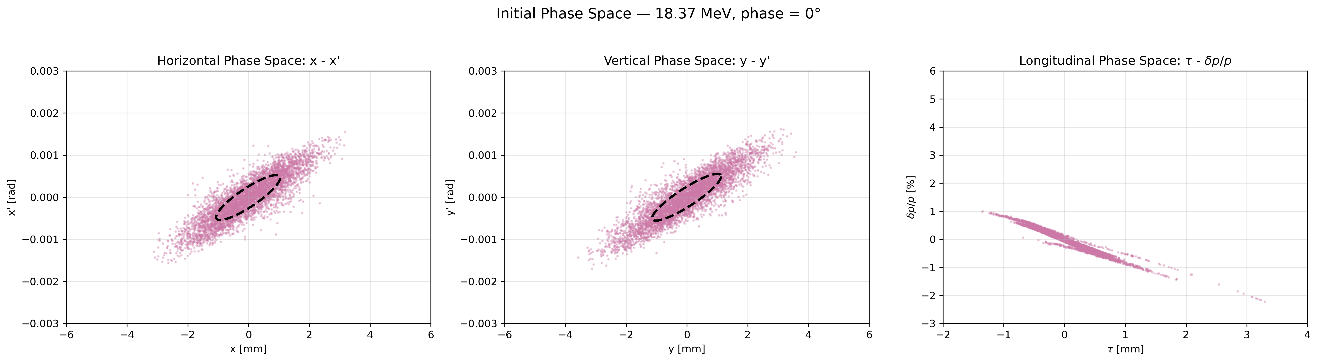

Slide 21
RESULTS OF DIFFERENT BEAMS
Energy / Charge | X emit [mm mrad] | X emit error [%] | X alpha | X alpha error [%] | X beta [m] | X beta error [%] | Y emit [mm mrad] | Y emit error [%] | Y alpha | Y alpha error [%] | Y beta [m] | Y beta error [%]
8.37 MeV - Reference | 0.582 | --- | -1.901 | --- | 4.305 | --- | 0.608 | --- | -2.100 | --- | 4.798 | ---
8.37 MeV - 0 pC | 0.582 | 0.000 | -1.901 | -0.000 | 4.305 | -0.000 | 0.608 | -0.000 | -2.100 | 0.000 | 4.798 | 0.000
8.37 MeV - 25 pC | 0.630 | 8.106 | -1.784 | -6.155 | 3.938 | -8.520 | 0.631 | 3.809 | -2.042 | -2.766 | 4.605 | -4.024
8.37 MeV - 50 pC | 0.674 | 15.777 | -1.689 | -11.162 | 3.637 | -15.528 | 0.653 | 7.468 | -1.990 | -5.208 | 4.431 | -7.638
8.37 MeV - 75 pC | 0.717 | 23.059 | -1.610 | -15.320 | 3.383 | -21.410 | 0.675 | 10.990 | -1.945 | -7.378 | 4.275 | -10.905
8.37 MeV - 100 pC | 0.757 | 30.047 | -1.543 | -18.868 | 3.166 | -26.462 | 0.695 | 14.391 | -1.904 | -9.323 | 4.132 | -13.883
11.79 MeV - Reference | 0.421 | --- | -1.972 | --- | 4.371 | --- | 0.439 | --- | -2.178 | --- | 4.871 | ---
11.79 MeV - 0 pC | 0.421 | -0.000 | -1.972 | 0.000 | 4.371 | 0.000 | 0.439 | -0.000 | -2.178 | 0.000 | 4.871 | 0.000
11.79 MeV - 25 pC | 0.439 | 4.380 | -1.903 | -3.480 | 4.163 | -4.746 | 0.448 | 2.011 | -2.146 | -1.497 | 4.765 | -2.158
11.79 MeV - 50 pC | 0.457 | 8.630 | -1.842 | -6.579 | 3.977 | -8.999 | 0.456 | 3.980 | -2.115 | -2.898 | 4.666 | -4.196
11.79 MeV - 75 pC | 0.474 | 12.760 | -1.787 | -9.361 | 3.810 | -12.837 | 0.465 | 5.910 | -2.087 | -4.213 | 4.572 | -6.124
11.79 MeV - 100 pC | 0.491 | 16.775 | -1.738 | -11.871 | 3.657 | -16.319 | 0.473 | 7.804 | -2.060 | -5.450 | 4.483 | -7.952
13.37 MeV - Reference | 0.373 | --- | -1.949 | --- | 4.326 | --- | 0.389 | --- | -2.151 | --- | 4.819 | ---
13.37 MeV - 0 pC | 0.373 | 0.000 | -1.949 | -0.000 | 4.326 | -0.000 | 0.389 | 0.000 | -2.151 | -0.000 | 4.819 | -0.000
13.37 MeV - 25 pC | 0.386 | 3.420 | -1.895 | -2.726 | 4.163 | -3.748 | 0.395 | 1.569 | -2.126 | -1.164 | 4.738 | -1.694
13.37 MeV - 50 pC | 0.398 | 6.757 | -1.847 | -5.213 | 4.015 | -7.185 | 0.401 | 3.113 | -2.102 | -2.269 | 4.660 | -3.314
13.37 MeV - 75 pC | 0.410 | 10.023 | -1.802 | -7.496 | 3.878 | -10.353 | 0.407 | 4.633 | -2.080 | -3.319 | 4.585 | -4.864
13.37 MeV - 100 pC | 0.422 | 13.223 | -1.761 | -9.604 | 3.751 | -13.286 | 0.413 | 6.131 | -2.058 | -4.320 | 4.513 | -6.351
16.03 MeV - Reference | 0.313 | --- | -1.872 | --- | 4.194 | --- | 0.327 | --- | -2.063 | --- | 4.670 | ---
16.03 MeV - 0 pC | 0.313 | 0.000 | -1.872 | -0.000 | 4.194 | -0.000 | 0.327 | 0.000 | -2.063 | -0.000 | 4.670 | -0.000
16.03 MeV - 25 pC | 0.320 | 2.340 | -1.837 | -1.851 | 4.084 | -2.612 | 0.330 | 1.082 | -2.046 | -0.787 | 4.615 | -1.179
16.03 MeV - 50 pC | 0.327 | 4.641 | -1.805 | -3.587 | 3.981 | -5.072 | 0.334 | 2.152 | -2.031 | -1.546 | 4.562 | -2.322
16.03 MeV - 75 pC | 0.334 | 6.909 | -1.774 | -5.224 | 3.883 | -7.396 | 0.337 | 3.211 | -2.016 | -2.279 | 4.510 | -3.431
16.03 MeV - 100 pC | 0.341 | 9.142 | -1.745 | -6.767 | 3.791 | -9.594 | 0.340 | 4.259 | -2.001 | -2.987 | 4.459 | -4.508
18.37 MeV - Reference | 0.274 | --- | -1.785 | --- | 4.043 | --- | 0.286 | --- | -1.962 | --- | 4.499 | ---
18.37 MeV - 0 pC | 0.274 | -0.000 | -1.785 | 0.000 | 4.043 | 0.000 | 0.286 | -0.000 | -1.962 | 0.000 | 4.499 | 0.000
18.37 MeV - 25 pC | 0.279 | 1.715 | -1.761 | -1.333 | 3.964 | -1.946 | 0.288 | 0.802 | -1.950 | -0.567 | 4.460 | -0.882
18.37 MeV - 50 pC | 0.283 | 3.410 | -1.738 | -2.605 | 3.889 | -3.807 | 0.291 | 1.597 | -1.940 | -1.119 | 4.421 | -1.743
18.37 MeV - 75 pC | 0.288 | 5.085 | -1.717 | -3.821 | 3.817 | -5.591 | 0.293 | 2.387 | -1.929 | -1.656 | 4.383 | -2.585
18.37 MeV - 100 pC | 0.293 | 6.742 | -1.696 | -4.985 | 3.748 | -7.302 | 0.295 | 3.170 | -1.919 | -2.180 | 4.346 | -3.409

Slide 22
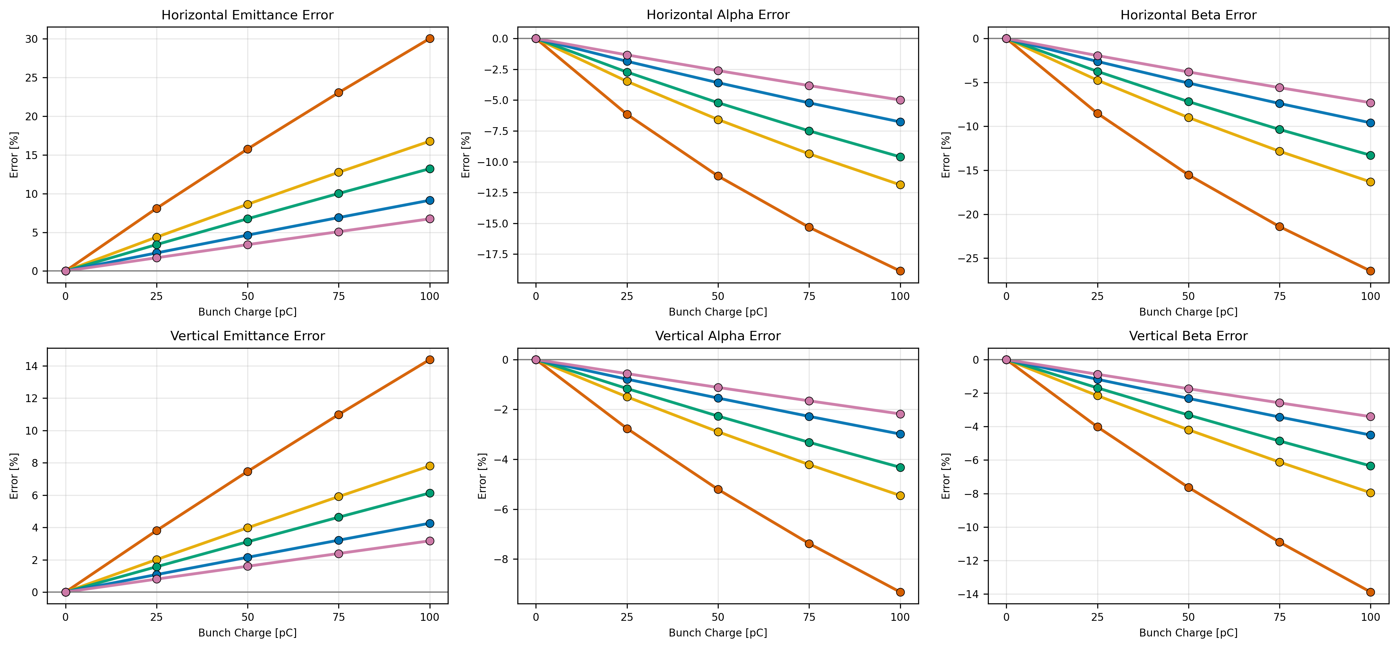
ERROR STUDY OF DIFFERENT BEAMS

Slide 23
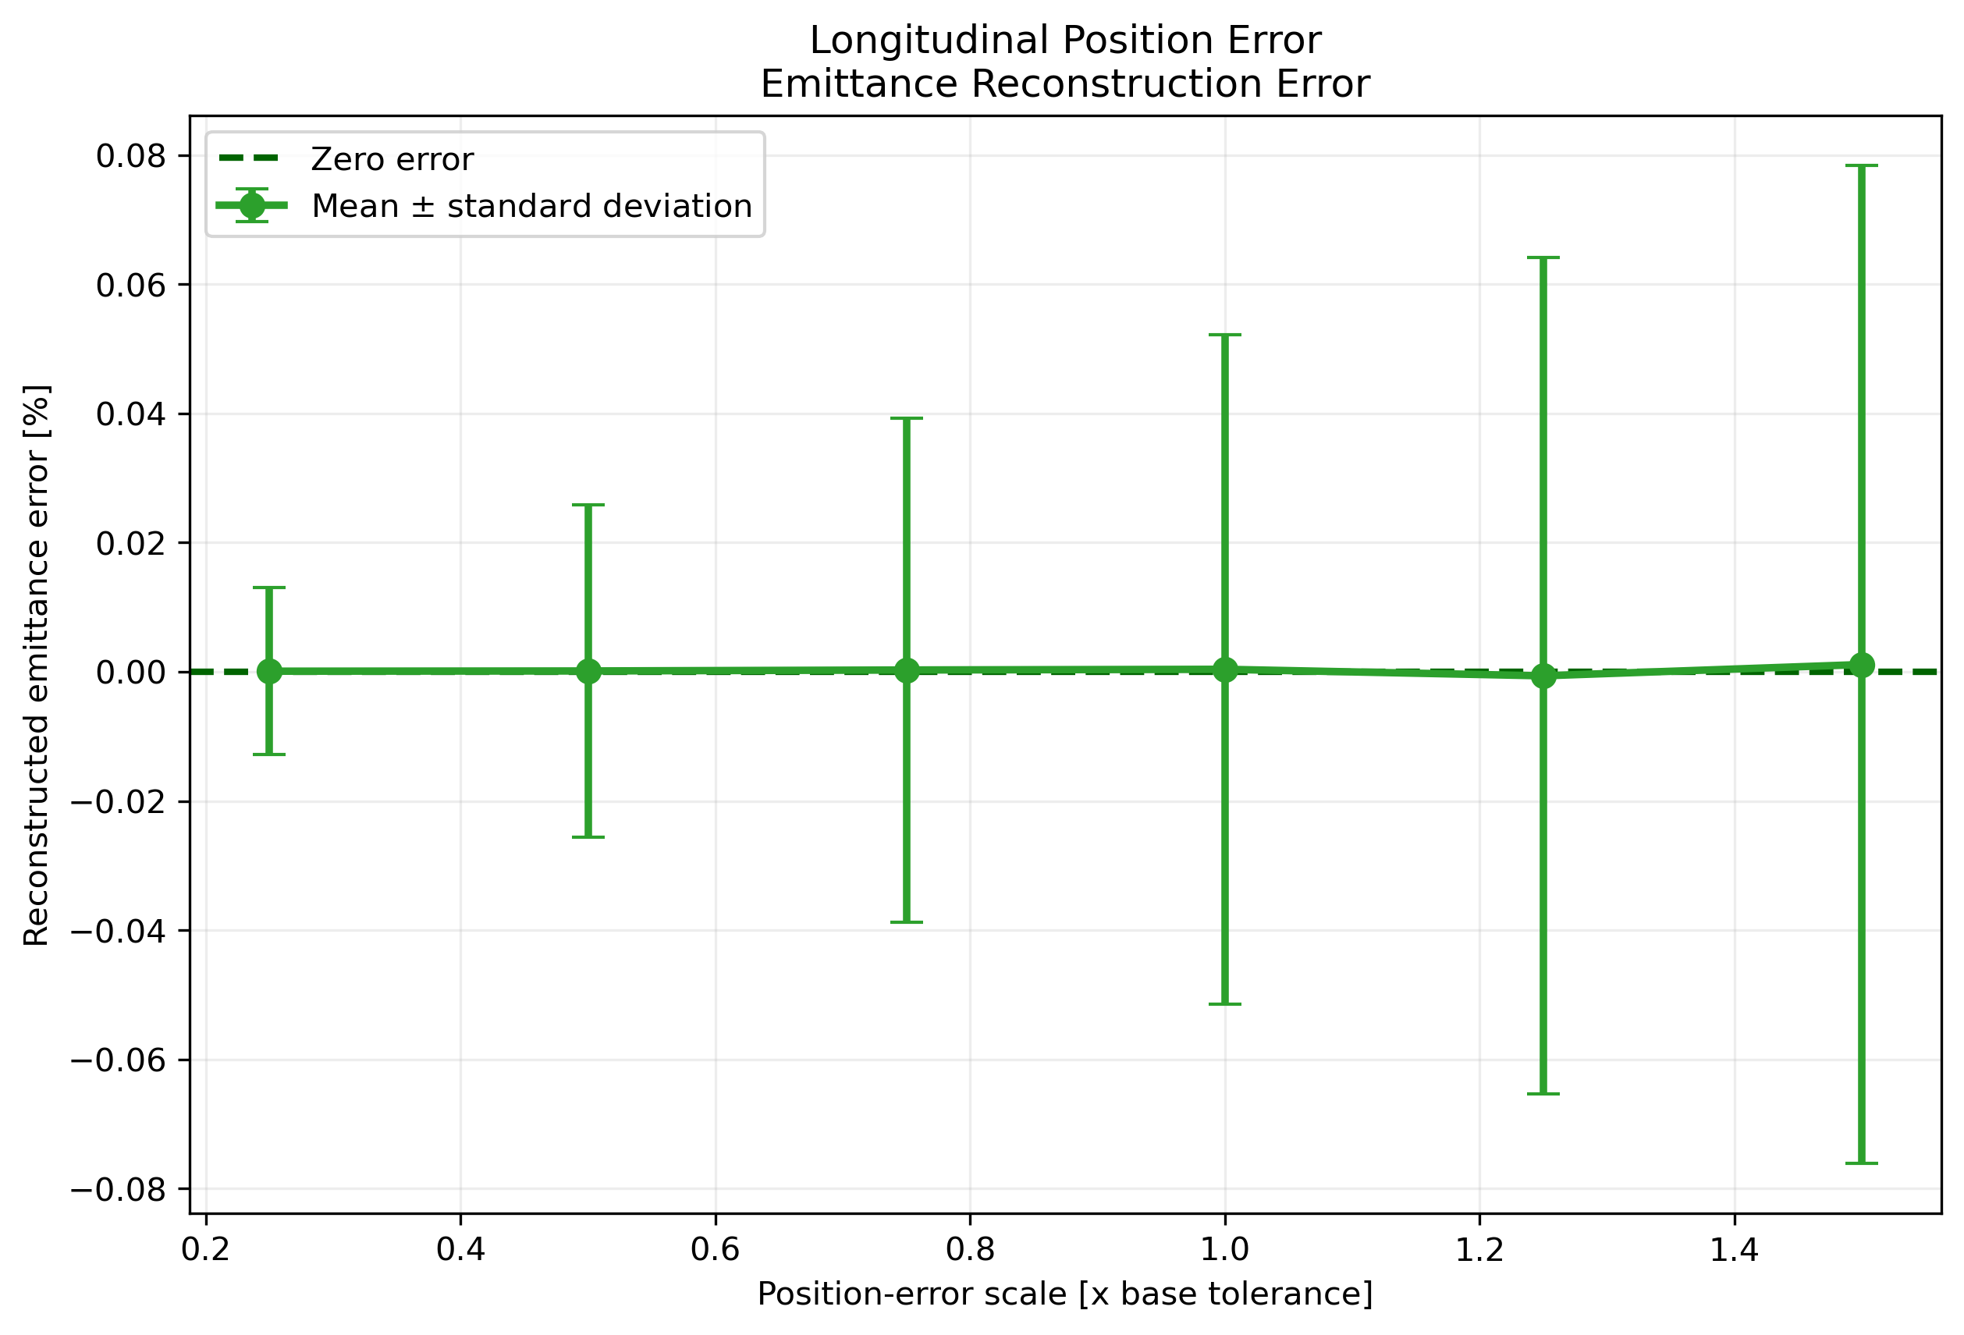
Positioning Error Study
Uniform distribution
Q1/Q2 position error: ±5 to ±30 µm
Screen position error: ±0.125 to ±0.75 mm

Slide 24
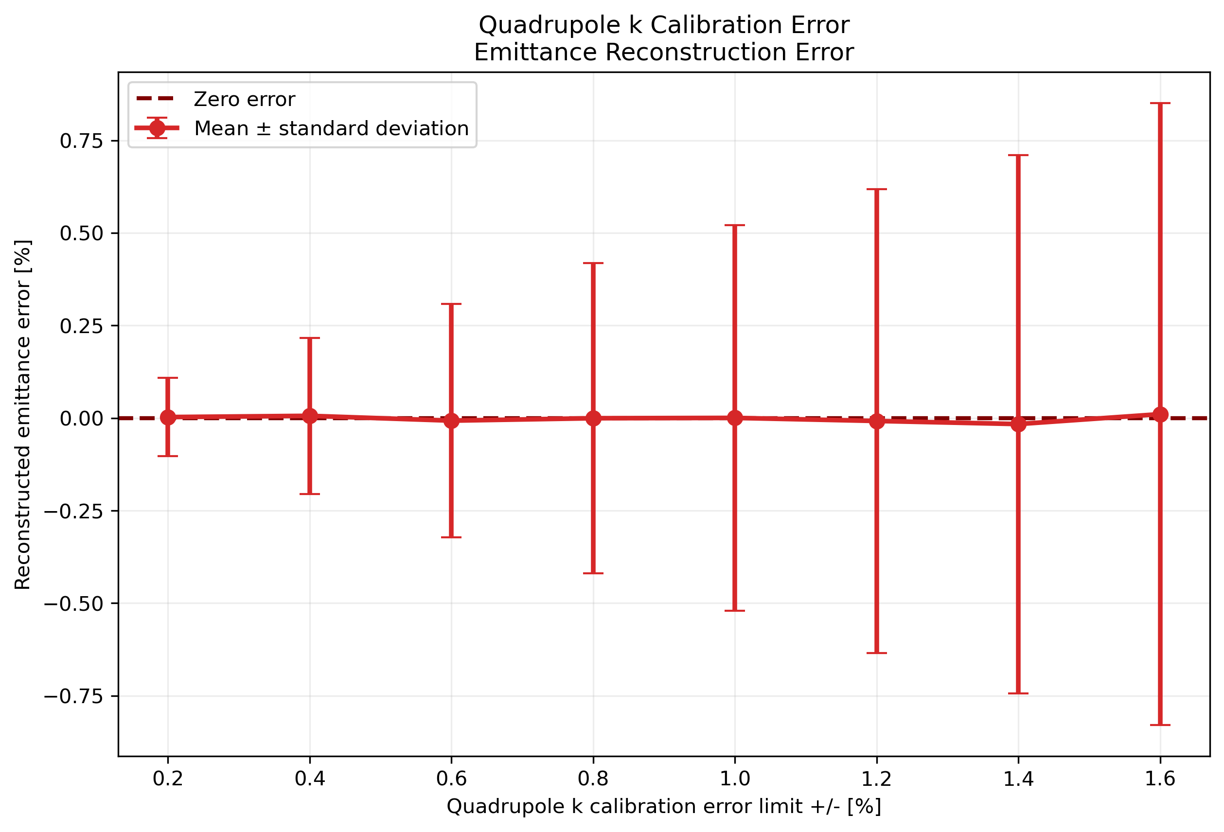
Quadrupole Strength Error Study
Uniform distribution
Independent errors for Q1 and Q2
Error range: ±0.2% to ±1.6%

Slide 25
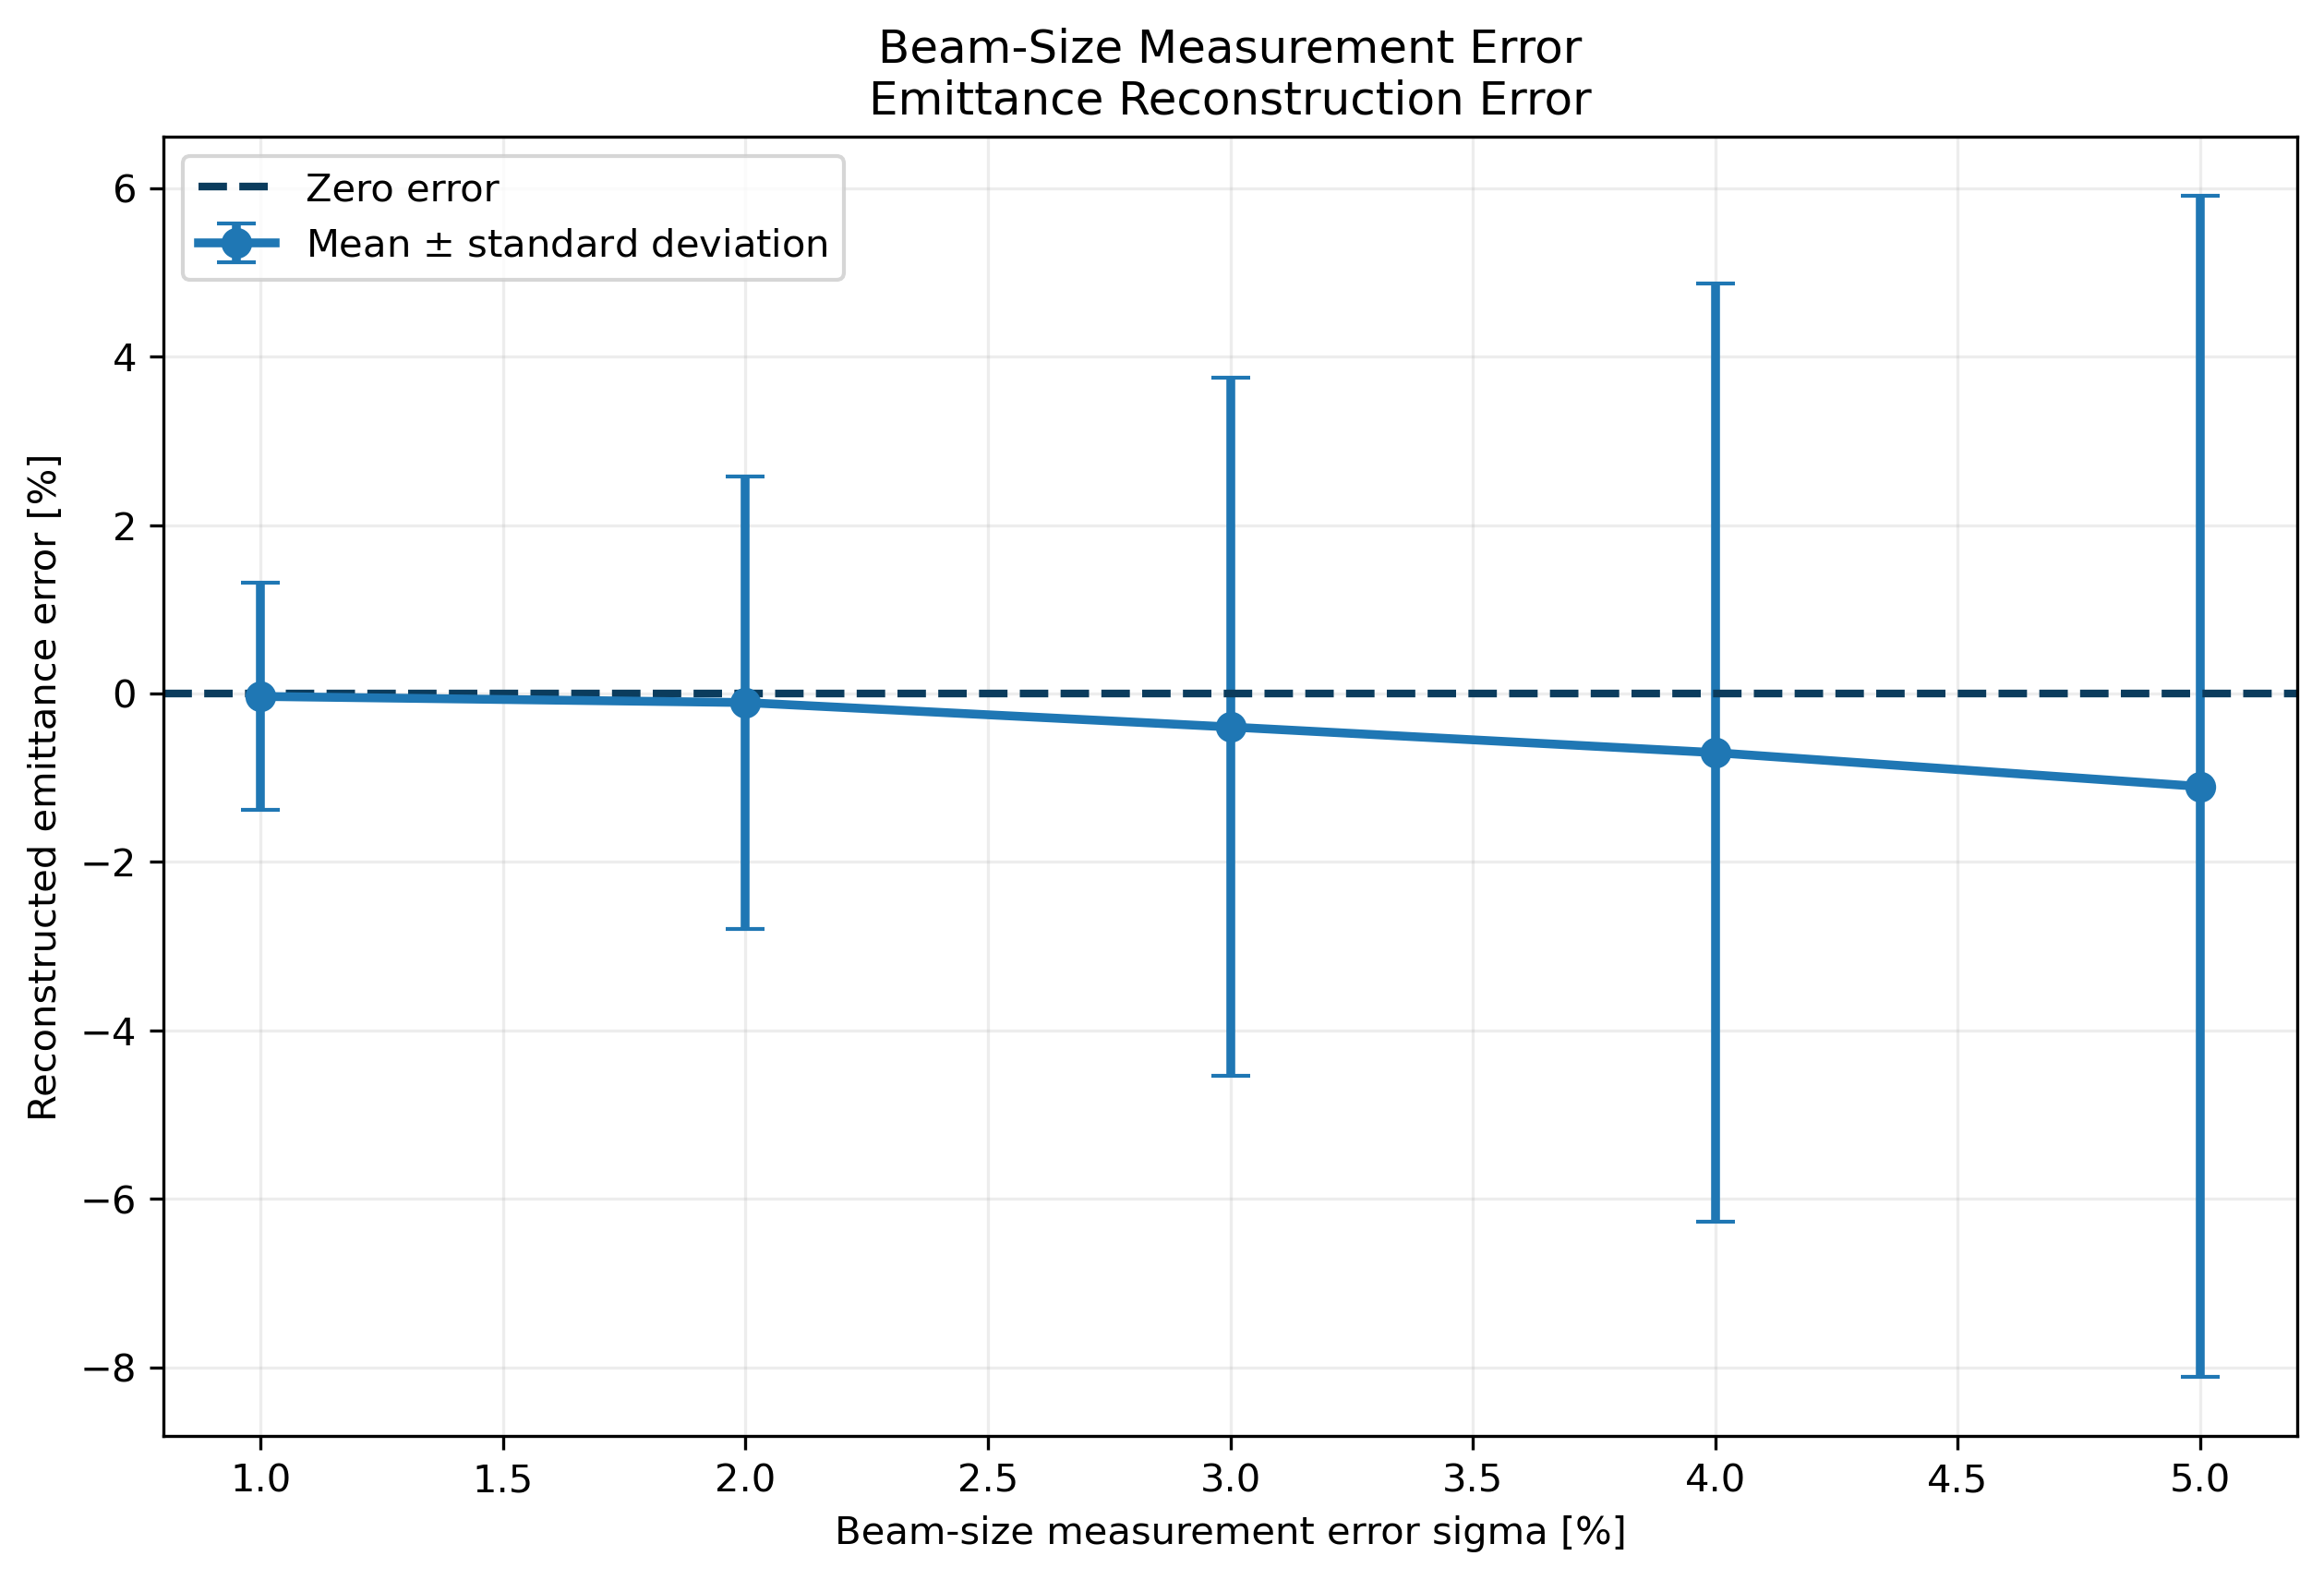
Beam Size Error Study
Gaussian distribution
Applied to measured beam size,
σ Error level: 1% to 5%

Slide 26
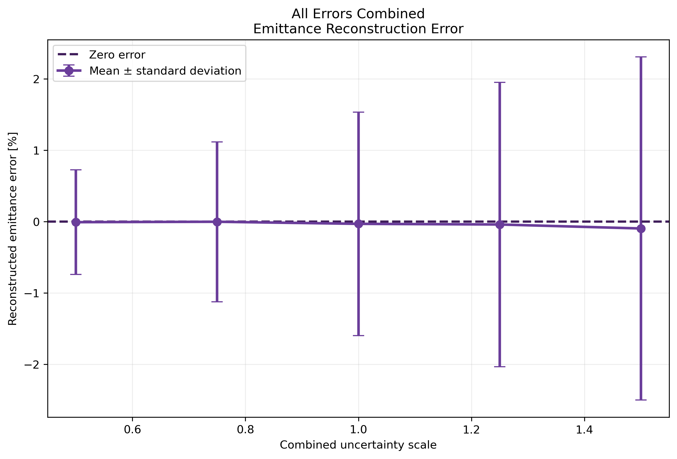
Combined Error Study
All error sources applied simultaneously
Beam size: 0.5–1.5%
GaussianQuadrupole k: ±0.5–±1.5%
UniformQ1/Q2 position: ±10–±30 µm
Screen position: ±0.25–±0.75 mm

